Slide 1
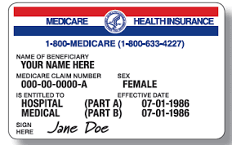
Medicare 101
As it relates to Active Employees
Updated October 2020

Slide 2
Outline
What Is Medicare?
The 4 Parts of Medicare
Part A - Hospital Coverage
When to Enroll in Part A
Part B - Medical Coverage
When to Enroll in Part B
Special Enrollment Period (SEP)
Part B Late Enrollment Penalty
Part B Late Enrollment Penalty Example
Part D – Prescription Drug Coverage
What’s Medicare Prescription Drug Coverage (Part D)?
Part D Initial Enrollment Period (IEP)
Special Enrollment Period (SEP)
Part D Late Enrollment Penalty
Group Health Plan Medicare Secondary Payer Coordination & Creditable Coverage Responsibilities
Who Pays First?
IRS/SSA/CMS Claims Data Match
Creditable Coverage Reporting
Creditable Coverage Disclosure

Slide 3
Acronyms
CC Creditable Coverage (Applies to Medicare Part D)
COBRA Consolidated Omnibus Budget Reconciliation Act
EGHP Employer Group Health Plan
ESRD End-Stage Renal Disease
GEP General Medicare Enrollment Period
IEP Initial Medicare Enrollment Period
OEP Medicare Open Enrollment Period
PDP Medicare Prescription Drug Plan
SEP Medicare Special Enrollment Period

Slide 4
What Is Medicare?
Government Health insurance for people
65 and older
Under 65 with certain disabilities (Likely to be the spouse or dependent of the active employee)
Any age with End-Stage Renal Disease
Notes:
Medicare currently provides health insurance coverage for 54 million U.S. citizens. That’s approximately 1 in every 6 Americans.
Medicare is health insurance for generally 3 groups of people:
Those who are 65 and older
People under 65 with certain disabilities who’ve been entitled to Social Security disability benefits for 24 months—includes Amyotrophic Lateral Sclerosis (ALS, also known as Lou Gehrig’s disease), without a waiting period
People of any age who have End-Stage Renal Disease (ESRD), which is permanent kidney failure that requires a regular course of dialysis or a kidney transplant

Slide 5
Active Employees and Medicare
Medicare-eligibility does NOT change the employee’s eligibility for employer group health coverage.
Employers must continue to offer employer group health coverage to employees who are Medicare eligible and/or enrolled in Medicare under the same terms available to non-Medicare eligible/enrolled employees.

Slide 6
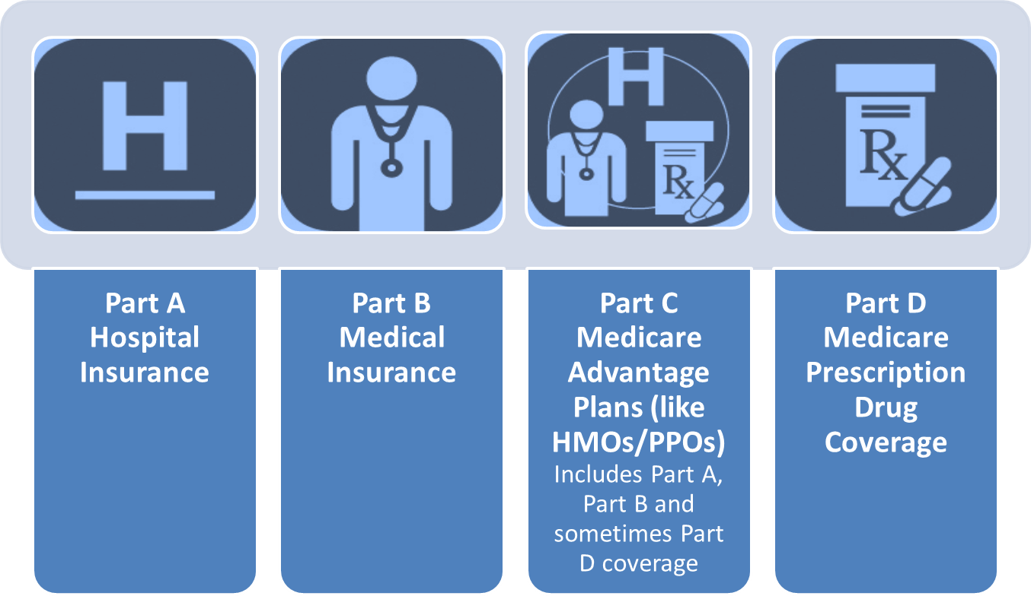
The 4 Parts of Medicare
Notes:
Medicare covers many types of services, and you have options for how to get your Medicare coverage. Medicare has 4 parts:
Part A (Hospital Insurance) helps pay for inpatient hospital stays, skilled nursing facility care, home health care, and hospice care.
Part B (Medical Insurance) helps cover medically necessary services like doctor’s visits and outpatient care. Part B also covers many preventive services (including screening tests and shots), diagnostic tests, some therapies, and durable medical equipment like wheelchairs and walkers. Together, Part A and Part B are also referred to as “Original Medicare.”
Part C (Medicare Advantage [MA]) is another way to get your Medicare benefits. It combines Part A and Part B, and sometimes Part D (prescription drug coverage). MA Plans are managed by private insurance companies approved by Medicare. These plans must cover medically necessary services. However, plans can charge different copayments, coinsurance, or deductibles for these services than Original Medicare.
Part D (Medicare Prescription Drug Coverage) helps pay for outpatient prescription drugs. Part D may help lower your prescription drug costs and protect you against higher costs in the future.

Slide 7
Part A Hospital Coverage

Slide 8
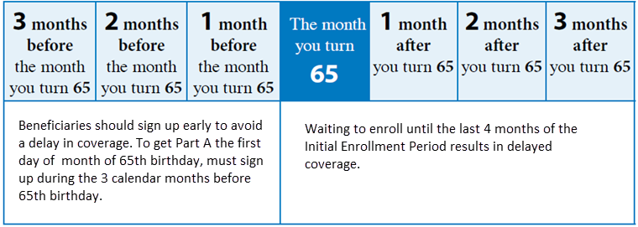
Enrollment in Part A
First enrollment - Initial Enrollment Period (IEP), which lasts 7 months
Enroll in premium-free Part A anytime after IEP begins (most people eligible for premium-free Part A)
No penalty for late enrollment in premium-free Part A
Must be enrolled in Part A if eligible and receiving Social Security Benefits
Enrollment will make employee ineligible for further contributions to an HSA.
Notes:
A beneficiaries first opportunity to enroll in Medicare is during their Initial Enrollment Period (IEP), which lasts 7 months.
Coverage starts based on when the beneficiary enrolls.
Enroll during the first 3 months of the Initial Enrollment Period (the 3 months before the month beneficiary turns 65), coverage will begin the first day of the month beneficiary turns 65.
If beneficiary enrolls the month turn 65, coverage will begin the first day of the next month.
If beneficiary enrolls in the last 3 months of IEP (the 3 months after you turn 65), coverage will begin 2 to 3 months after turn 65.
If beneficiary eligible for premium-free Part A, can enroll in Part A when IEP begins (3 months before turn 65) and any month afterward.
If you're not eligible for premium-free Part A, you can only enroll in Part A during your IEP or during the limited Part B enrollment periods.

Slide 9
Part B Medical Coverage
Notes:
Supplement Plans
Medicare A & B both have deductibles and other cost-shares that are not covered by Medicare, and therefore due from the Member.
The federal government has approved Medicare Supplement plans to offset those costs. Some plans cover the deductibles and the coinsurance, others cover one deductible, but not the other, some cover no deductibles, just coinsurance
Supplements are offered in both the group and individual markets – these plans do not cover prescriptions.
Part C – Medicare Advantage Medicare Advantage Plans
Takes the place of Parts A, B and usually Part D.
Run by Medicare- approved private insurance companies that follow rules set by Medicare.
May include extra benefits and services for an extra cost.
These plans can have more out of pocket exposure and limited networks, depending on the plan design selected.
Carveouts- when Medicare Primary and have access to other coverage- allow for a lower premium, as plan only covers what Medicare does not.

Slide 10
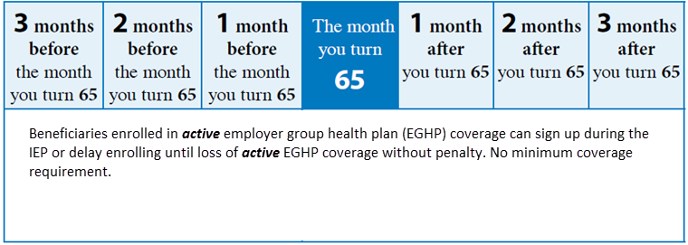
Enrollment in Part B
Like Part A – Beneficiaries can enroll in Part B during IEP
Part B has a monthly premium, which is indexed based on income
Employees covered by employer group health plan (EGHP) can enroll in Part B after active EGHP coverage ends without penalty
“Minimum” EGHP coverage level not required
Enrollment in Part A required to enroll in Part B
Enrollment will make employee ineligible for further contributions to an HSA.
Notes:
For everyone (whether premium-free Part A or have to pay a premium for it), can only enroll in Part B during:
Your IEP (just explained under Part A)
The annual General Enrollment Period (GEP) January 1–March 31 each year
In limited situations, a Special Enrollment Period (SEP) – Unlike Part D (later) no minimum level of coverage required.
If not enrolled in Part B during IEP, may have to pay a penalty. For Part B, it's a lifetime penalty for as long as you have Part B.

Slide 11
Part B Special Enrollment Period (SEP)
Must have been enrolled in EGHP coverage based on active, current employment of self or spouse
Can enroll in Part B
Anytime still covered by EGHP, or
When employment ends,
Beneficiary eligible for SEP
Must enroll within 8 months of the loss of coverage or current employment, whichever happens first
Usually no penalty if signed up within 8 months of active employer coverage ending
Taking COBRA or retiree coverage and delaying Part B enrollment will result in penalty
Notes:
There are very few Special Enrollment Periods (SEPs) for Part B allowed by law.
An important SEP allows a beneficiary to enroll after their IEP and not wait for the General Enrollment Period (GEP), and there is no penalty.
To be eligible, must have employer group health plan (EGHP) coverage based on active, current employment.
If you're 65 or older, beneficiary must get this employer-sponsored coverage based on employee’s or spouse’s current employment.
Disability-based Medicare, beneficiary can also have employer-sponsored coverage based on a member’s current employment.
People who get Medicare based on End-stage Renal Disease don’t qualify for an SEP.
Beneficiary must have this EGHP coverage for all the months you were eligible to enroll in Part B, but didn’t.
For most people, this means beneficiary had EGHP coverage since turning 65.
If eligible, can enroll using the SEP at any time while having EGHP coverage based on active, current employment.
Loss of either the EGHP coverage or the current employment, have 8 months to enroll.
Don’t enroll within the 8 months, have to wait until the next GEP to enroll, will have a gap in coverage, and may have to pay a penalty.
It's important to note that Consolidated Omnibus Budget Reconciliation Act (COBRA), retiree coverage, long-term worker’s compensation, or Veterans Affairs coverage isn't considered active, current employment.

Slide 12
Part B Late Enrollment Penalty
General Enrollment Period (GEP)
January 1–March 31 annually
Coverage starts July 1
Pay a penalty
10% for each full 12 months eligible, but not enrolled in Part B for as long as beneficiary enrolled in Part B
Notes:
If beneficiary didn’t sign up for Part B during IEP, can enroll during the General Enrollment Period (GEP).
The GEP occurs January 1 through March 31 each year. If enroll in the GEP, your coverage will begin July 1.
If beneficiary doesn’t enroll in Part B when first eligible and more than 12 months have passed since turned 65 (and not eligible for SEP), have to pay a penalty added to monthly Part B premium.
The Part B penalty is 10% for each full 12-month period could’ve had Part B, but didn’t sign up for it.
In most cases have to pay this penalty for as long as you have Part B.

Slide 13
Part B Late Enrollment Penalty Example
Mary’s EGHP coverage ended September 30, 2013. She waited to sign up for Part B until the General Enrollment Period in March 2016.
Total time Mary delayed Part B: 30 months
Mary’s Late Enrollment Penalty: 20% (30 months includes 2 full 12-month periods)
The penalty is added to the Part B monthly premium
2017 Monthly Part B premium = $134.00
Mary’s Monthly Part B premium = $160.80
Mary will have the penalty for as long as she has Part B

Slide 14
Part D Prescription Drug Coverage

Slide 15
What’s Medicare Prescription Drug Coverage (Part D)?
Medicare drug plans
Approved by Medicare
Run by private companies
Available to everyone with Medicare
Uniform coverage minimum
Must be enrolled in Parts A and B to enroll in D
Beneficiaries must join a plan to get coverage
Enrollment will make employee ineligible for further contributions to an HSA.
Notes:
Medicare prescription drug coverage (Part D) adds to Medicare health care coverage.
It helps pay for medically necessary brand-name and generic prescription drugs.
Medicare drug plans are offered by insurance companies and other private companies approved by Medicare. All people with Medicare are eligible to enroll in a Medicare drug plan. To get coverage, beneficiary must join a plan–enrollment isn't automatic for most people.

Slide 16
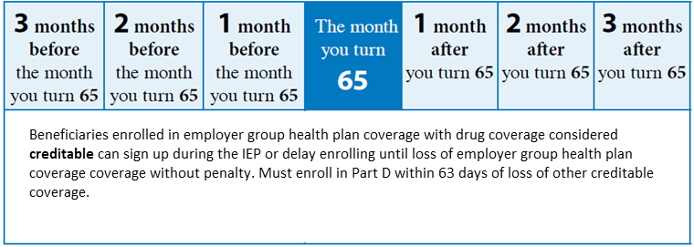
Enrollment in Part D
Like Part B – Employees can enroll in Part D during IEP
Employees covered by EGHP providing creditable coverage (All VEHI plans are creditable) can enroll in Part D after EGHP coverage ends (or any other creditable drug coverage)
Must enroll within 63 days of the loss of coverage
Notes:
When beneficiary first becomes eligible to get Medicare, has a 7-month Initial Enrollment Period (IEP) for Part D (like Part A and B):

Slide 17
Special Enrollment Period
Life events that allow a Part D SEP include
Beneficiary loses other creditable prescription coverage (e.g., EGHP)
Beneficiary was not properly told that existing coverage wasn’t creditable, or other coverage is reduced and is no longer creditable
Other specific circumstances (not employment related)

Slide 18
Part D Late Enrollment Penalty
Higher premium if not enrolled when first eligible
Exception if beneficiary had other creditable coverage
Penalty paid for as long as covered by Part D
1% of base beneficiary premium
For each full month eligible and not enrolled or covered by creditable coverage
Example 28 month penalty:
Average monthly premium = $48.75
Premium with penalty (28%) = $62.40
Notes:
If beneficiary has other creditable drug coverage (e.g., through employment), can defer enrollment without penalty. Become eligible for SEP:
If you lose your other creditable prescription drug coverage
If you weren’t properly told that your other coverage wasn’t creditable, or that the other coverage was reduced so that it’s no longer creditable
NOTE: It’s important to remember that the SEPs for Part B and Part D have different time frames for when beneficiaries can sign up for coverage. Beneficiaries may be eligible for a Medicare Part B SEP if over 65 and beneficiary (or spouse) are still working and have health insurance through current active employment. Part B SEP lasts for 8 months and begins the month after employment ends. However, Part D SEP lasts for only 2 full months after the month coverage ends.

Slide 19
Group Health Plan Medicare Secondary Payer& Part D Creditable Coverage Responsibilities

Slide 20
Coordinating-Who Pays First?
Medicare generally requires the employer group health plan to pay first. Medicare will only cover eligible costs not covered by the employer’s plan.
Exceptions - Medicare will pay first:
If the employer has fewer than 20 employees in total (generally not applicable to the VEHI association)
Disability-based Medicare for employers will fewer than 100 employees
End Stage Renal Disease after the 30th month
Notes:
Medicare pays second for people if they’re eligible for Medicare due to End-Stage Renal Disease (ESRD) and are covered by an EGHP (either theirs or their spouse’s)
The EGHP is primary for the first 30 months of Medicare entitlement based on ESRD
Medicare pays first for people after the 30-month coordination period has ended, and the EGHP pays second.
If the EGHP is still in the 30-month primary period and the EGHP could have changed to secondary (e.g., the employee retires and the EGHP would normally be secondary), the EGHP remains primary for the balance of the 30-month period.

Slide 21
Mandatory Reporting Health Care Spending Accounts
Flexible Spending Accounts - NO
Health Reimbursement Accounts – Maybe
HRA value $5,000 or greater
Your HRA Administrator should handle reporting if required
Health Savings Accounts – NO. However, best practice is for ER to inform employees ages 60 and over that enrollment in any part of Medicare will make them ineligible to contribute (or for the employer to contribute) to an HSA. All funds currently in the HSA, however, remain with the employee to use for qualified medical expenses. At age 65, HSA distributions become more flexible.
Notes:
HRAs consist of funds set aside by employers to reimburse employees for qualified medical expenses, just as an insurance plan will reimburse covered individuals for the cost of services incurred.
HRAs are considered to be Group Health Plans (GHPs) and thus HRA coverage is subject to Section 111 Medicare Secondary Payer (MSP) Reporting.
HRAs with an annual benefit amount of less than $5,000 are exempt from reporting. Only HRA coverage that reflects an annual benefit value of $5,000 or more must be reported.
Due to carry-over or roll-over options in an HRA, if the value of the HRA starts at less than $5,000 but grows to meet or exceed $5,000, the HRA must be reported when the increase to $5,000 or more occurs.
Check with your HRA administrator, they should be handling the reporting. Make it part of your request for services.

Slide 22
Data Match Requests
Previously, employers were required to provide CMS with information regarding health coverage of their Medicare-eligible workers and spouses of Medicare-eligible individuals whenever CMS identified those individuals to the employer.
The Data Match program has been discontinued.
Although the Data Match process has been ended, employers may voluntarily enter into an Employer Voluntary Data Sharing Agreement with CMS to exchange group health plan and Medicare entitlement data. For more information on the VDSA program, see the Voluntary Data Sharing Agreement page.

Slide 23
Part D - Creditable Coverage
Required employer actions
What is required?
Verify with VEHI the plan options provide creditable coverage (they are creditable at this time)
Notice (disclosure) to all Medicare Eligible Individuals (Employees and/or Dependents)
May send to all employees annually to be sure no one is missed
Reporting of Creditable Coverage to CMS

Slide 24
Part D - Creditable Coverage
Credit Coverage Disclosure and Notice Distribution
Individual | Report to CMS
Provide prior Medicare Part D annual election period - October 15th (within the past 12 months)* | Within 60 days after first day of plan year (defined as VEHI renewal timing) VEHI Renewal is 7/1/17-6/30/18; therefore reporting due August 30, 2017
Prior to an individual’s Initial Enrollment Period for Part D*
Prior to the effective date of coverage for any Medicare eligible individual that joins the plan*
Whenever prescription drug coverage ends or changes so that it is no longer creditable or becomes creditable | Within 30 days after termination of prescription drug plan or change in creditable status of prescription drug plan
Upon request of the employee (beneficiary)
*Disclosure notice may be provided to all plan participants to meet the CMS requirements

Slide 25
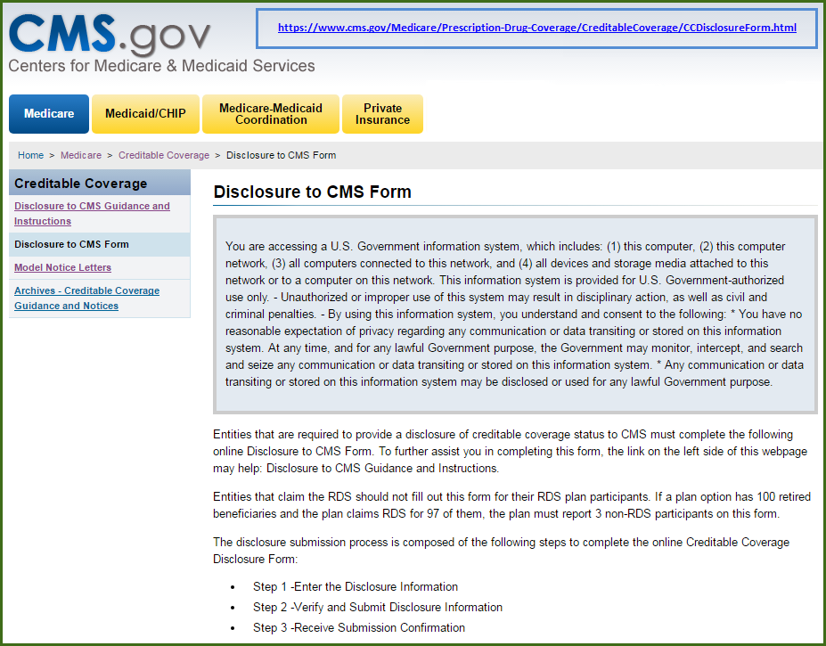
Part D - Creditable Coverage Reporting
Notes:
This is a screen shot of where EGHP reports Creditable Coverage Status. Handouts #3 and 4 provide instructions and screen shots to enter information.

Slide 26
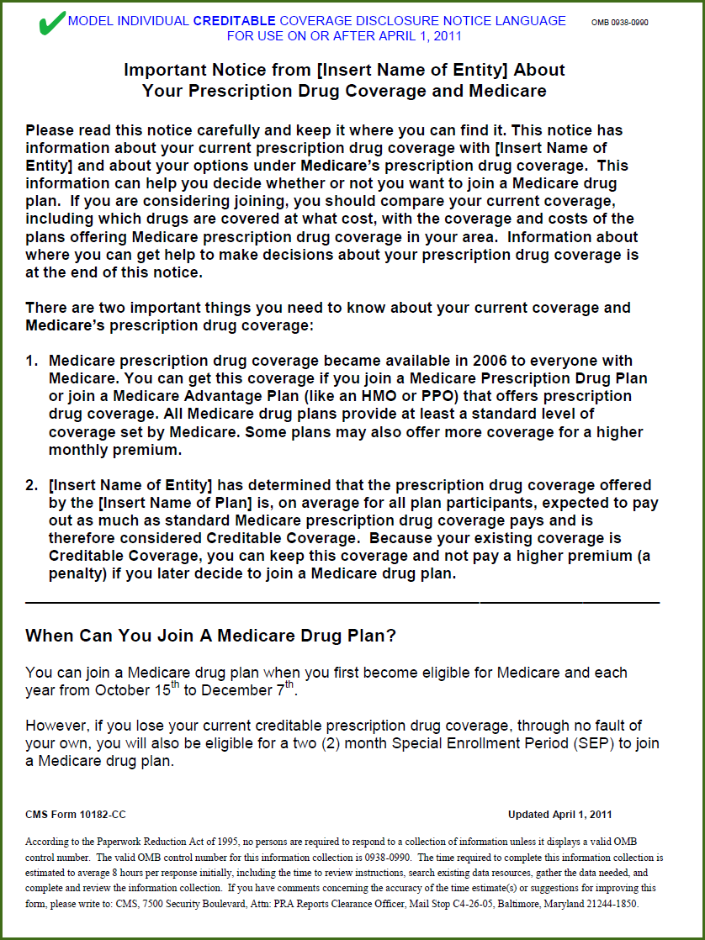
Part D - Creditable Coverage Notice
Use BCBSVT Employer Resource Center to obtain listing of employees who will be turning 65 in upcoming year.
Notes:
These are images of the first page of the two Creditable Coverage notices – Creditable Coverage and NON-Creditable Coverage
Handouts 5a and b are PDF models with editable Word documents attached.

Slide 27
resources
Medicare: www.medicare.gov
Social Security: www.ssa.gov
Medicare & You 2017: https://www.medicare.gov/pubs/pdf/10050-Medicare-and-You.pdf

Slide 28
Questions?

